Slide 1
Cloud Computing

Slide 2

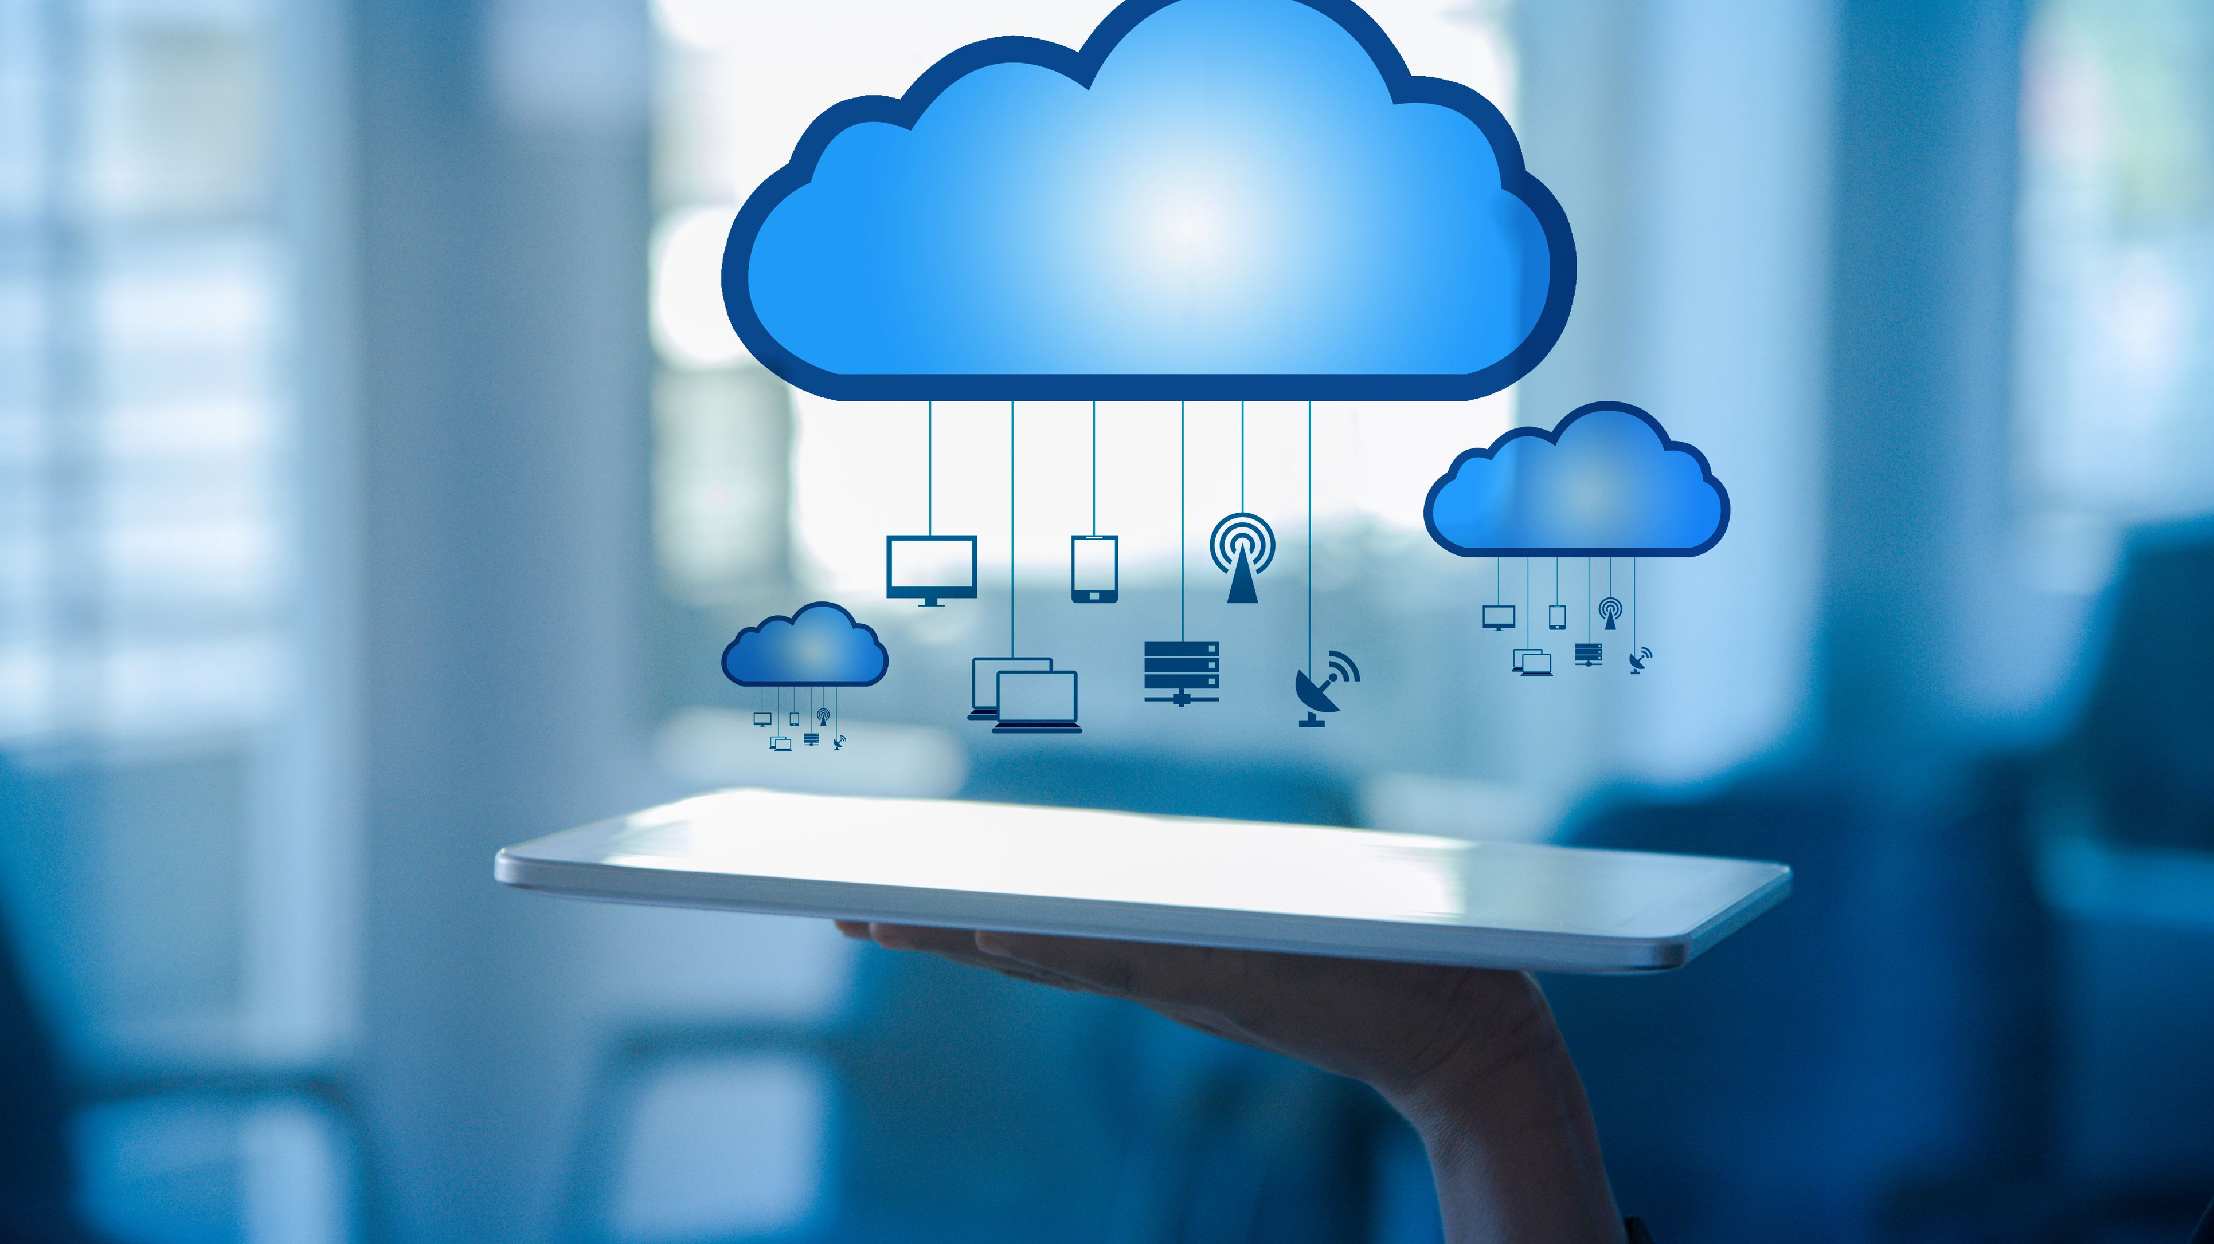
What?
Accessibility of hardware and software through internet
Group of connected devices
Notes:
But first what is cloud computing. Cloud computing is making hardware and software available through the internet. A cloud is referring to a group of devices that are connected to each other to make a network and is then called a cloud of computers.

Slide 3
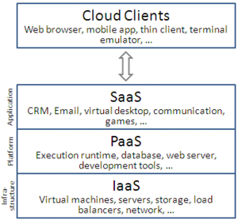
How does it work
Service oriented architecture
Provide services according to models
3 standard models
Notes:
How does it work? Through a service oriented structure which means “everything as a service” but cloud computing providers offer their services according to different models of which three standard models exist. These models are portrayed as layers in a stack because they offer increasing abstraction. Also the consumer doesn’t need to maintain this network because the provider has all the liabilityNow I will be giving some more information about the different models.

Slide 4
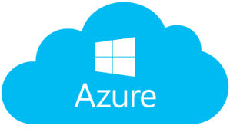
Infrastructure as a Service
Online services
APIs
Network structure
Maintained by hypervisor
Notes:
Infrastructure as a service refers to online services that provide high level APIs used to abstract various low-level details of underlying network infrastructure like physical computing resources, location, data partitioning, scaling, security, backup and much more. Hypervisors which runs virtual machines as guests, can support large numbers of virtual machines and the ability to scale services up and down according to customers' varying requirements.

Slide 5
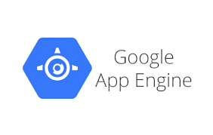
Platform as a Service
Development environment
Toolkit and standards
Computing platform(OS, language, database...)
Notes:
Platform as a Service vendors offer a development environment to application developers. The provider typically develops toolkit and standards for development and channels for distribution and payment. In this model, cloud providers deliver a computing platform, typically including operating system, programming-language execution environment, database, and web server. Some vendors also manage the underlying computer and storage resources to scale automatically to match application demand so that the cloud user does not have to allocate resources manually.

Slide 6
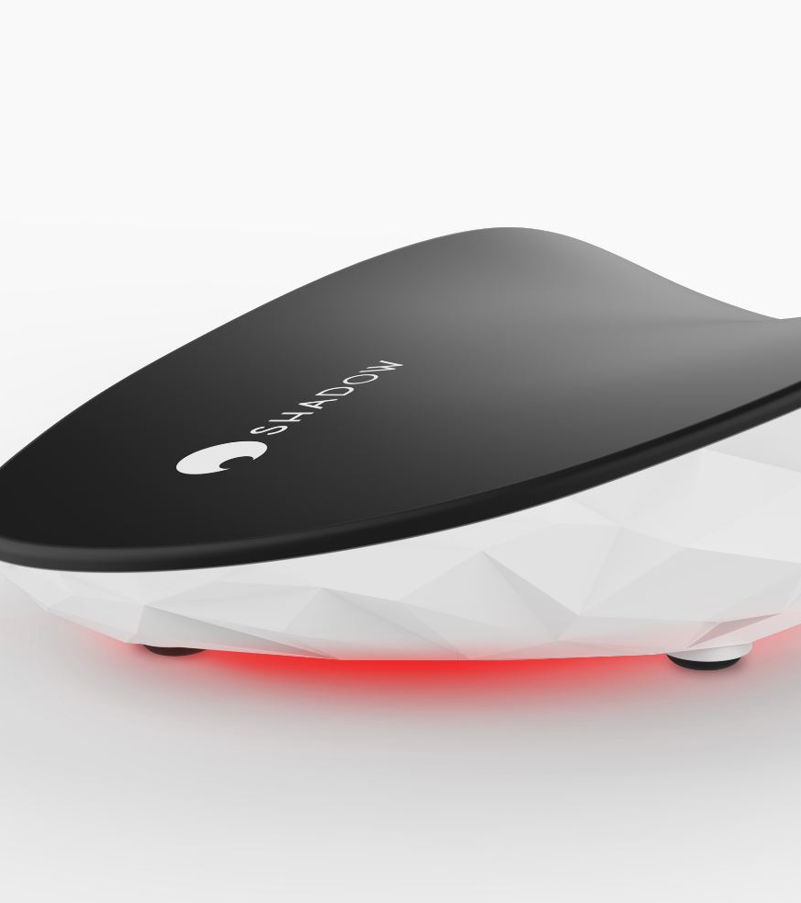
Software as a Service
Access to software and databases
Pay per use or subscription
Maintained by providers
Notes:
In the software as a service model, users gain access to application software and databases. Cloud providers manage the infrastructure and platforms that run the applications. It is sometimes referred to as "on-demand software" and is usually priced on a pay-per-use basis or using a subscription fee. In this model, cloud providers install and operate application software in the cloud and cloud users access the software from cloud clients. Cloud users do not manage the cloud infrastructure and platform where the application runs. This eliminates the need to install and run the application on the their own computers, which simplifies maintenance and support. Cloud applications differ from other applications in their scalability which can be achieved by cloning tasks onto multiple virtual machines at run-time to meet changing work demand.

Slide 7

Disadvantages
Privacy
Limitations of customizablitiy
Notes:
There are some disadvantages to cloud computing though like the privacy aspect of it. The provider has full control so they can see everything you do. Also there are limitations to the customizability of the clouds because they offer a selection and not all programs.

Slide 8
Thank you for your attention

